Slide 1



CASE STUDY
Implementing a Robust VPN Solution for Secure
Remote Access to Cloud Resources
Presented By.
Name Registration No.
1. Ankit Kumar 2241016052
Panda
2. Piyush Kumar Sahoo 2241019096
3. Barun Kumar Rout 2241018145

Slide 2

TABLE OF CONTENTS
SL. NO. | TITLE
1 | INTRODUCTION
2 | MOTIVATION
3 | WITHOUT VPN VS WITH VPN
4 | SOLUTION DEVELOPMENT
5 | IMPLEMENTATION
6 | RESULT
7 | CONCLUSION
8 | REFERENCES

Slide 3
INTRODUCTION
Organizations increasingly depend on cloud resources (AWS EC2, RDS, etc.)
Remote work culture requires employees to access cloud services from anywhere.
Directly exposing resources to the internet leads to security threats.
A VPN solution allows secure and private connectivity to AWS VPC resources.
This project focuses on AWS Client VPN with IAM authentication to provide safe and scalable access.

Slide 4
MOTIVATION
Protect sensitive business data from cyberattacks and unauthorized access.
Provide remote teams with seamless and secure connectivity.
Eliminate risks of public-facing SSH/RDP connections.
Reduce operational complexity with IAM-based authentication.
Ensure the solution is robust, scalable, and easy to manage for future needs.

Slide 5

WITHOUT VPN VS WITH VPN
Without VPN:
Data travels in plaintext over the internet.
Easy for attackers to sniff/modify traffic.
No identity verification of users.

Slide 6

With VPN:
Data is encrypted using protocols (AES, IPsec).
Private tunnel → only authenticated users connect.
Cloud resources hidden from direct internet exposure.
Strong authentication: Certificates, IAM, MFA.

Slide 7
SOLUTION DEVELOPMENT
Our proposed VPN solution integrates modern security protocols and architectures:
Site-to-Site VPN for organization-to-cloud secure link.
(IKEv2 + IPsec)
Point-to-Site VPN for individual remote user access.
Robust Authentication & Key Exchange (OpenVPN, Certificates, MFA).

Slide 8
SOLUTION DEVELOPMENT
Site-to-Site VPN Architecture:
Use Case:
Connects an organization’s on-premises data center securely with cloud VPC.
How it works:
A VPN gateway (router/firewall) at each site.
Tunnels established via Ipsec+IKEv2.
Encrypted communication between data center and cloud resources.
Advantages:
Permanent connection.
Best for multiple users in branch offices.

Slide 9
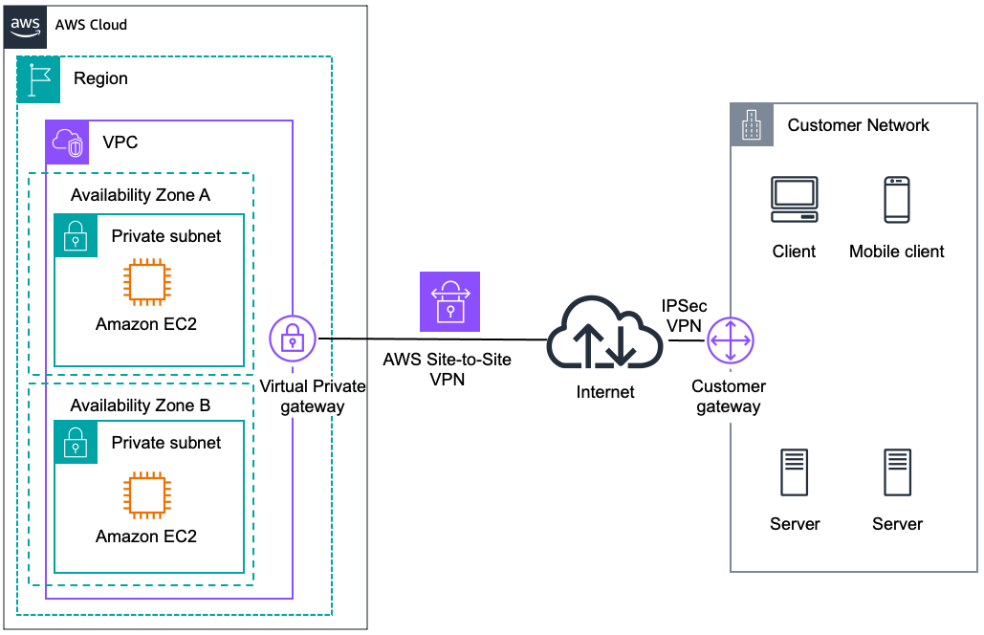
SOLUTION DEVELOPMENT
Fig : Site-To-Site VPN Architecture

Slide 10
SOLUTION DEVELOPMENT
Point-to-Site VPN Architecture:
Use Case:
Individual employees working remotely.
How it works:
User installs VPN client on laptop/phone.
Client authenticates via certificate / username-password + MFA.
Secure tunnel established directly to Cloud VPN gateway.
Advantages:
Flexible – works from anywhere.
Best for small teams or remote users.

Slide 11
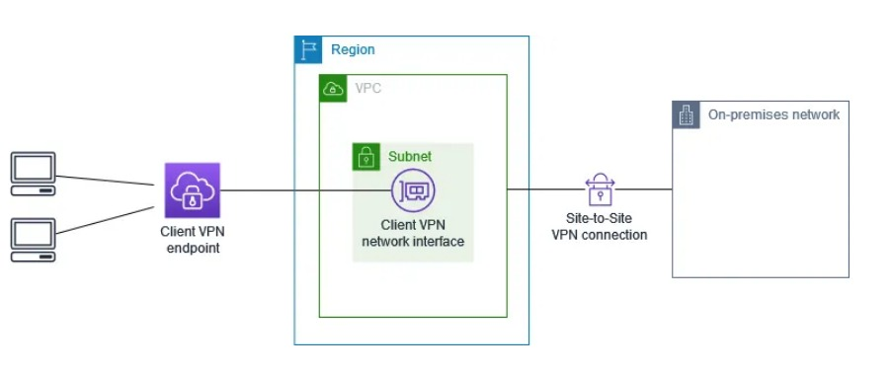
SOLUTION DEVELOPMENT
Fig : Point-To-Site VPN Architecture

Slide 12
SOLUTION DEVELOPMENT
Authentication & Key Management :
Key Exchange (TLS Handshake):
Uses OpenVPN (TLS/SSL) for secure tunneling.
Diffie–Hellman ensures unique keys per session.
Authentication Mechanisms:
Using Digital Certificates: Each client and server has its own certificate issued by a trusted CA.
Certificates validate identities.
Multi-Factor Authentication Integration Session Security:
Perfect Forward Secrecy (PFS) ensures new keys per session(Uses Diffie–Hellman).
Even if one session key is compromised, past/future sessions remain safe.

Slide 13
IMPLEMENTATION
Step 1: Set Up VPC, Subnets, and Route Tables.
VPC (VPN): (10.0.0.0/16)
Creating Subnets:-
Public Subnet (PUB): 10.0.1.0/24
Private Subnet (PVT): 10.0.2.0/24
Creating Internet Gateway:-
Internet Gateway (IGW): VPN-IGW
Creating Route Table:-
Public Route Table (PUB-RT)
Private Route Table (PVT-RT)
Creating Associations:-
Associate IGW and PUB-RT with the PUB subnet
Associate PVT-RT with the PVT subnet

Slide 14
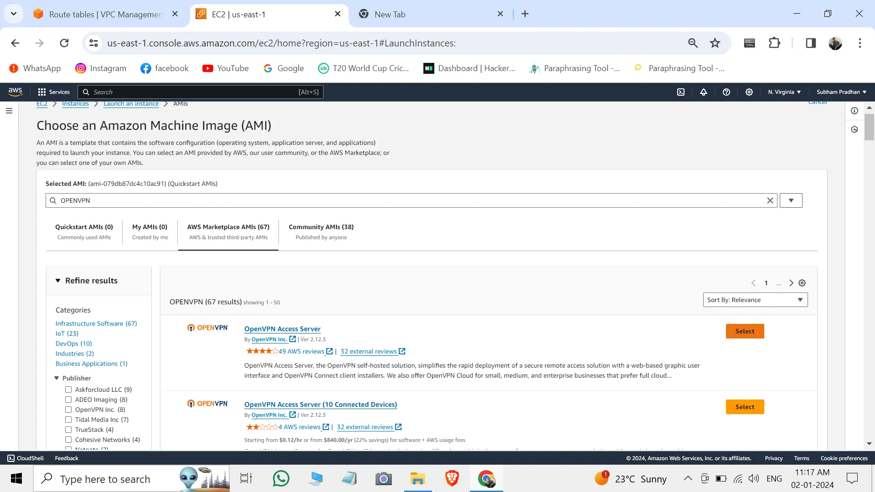
IMPLEMENTATION
Step 2: Launch OpenVPN Server
Launch an EC2 instance named “OPENVPN” using the OpenVPN AMI.
Set a password for the OpenVPN Admin UI and Client UI.
Copy the Admin UI and Client UI.

Slide 15
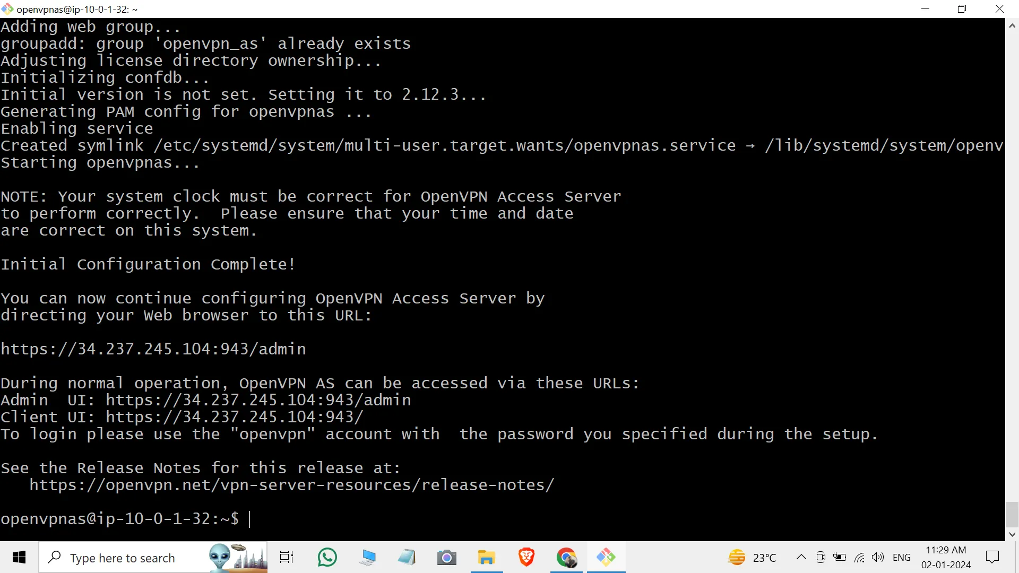
IMPLEMENTATION
Step 2: Launch OpenVPN Server

Slide 16
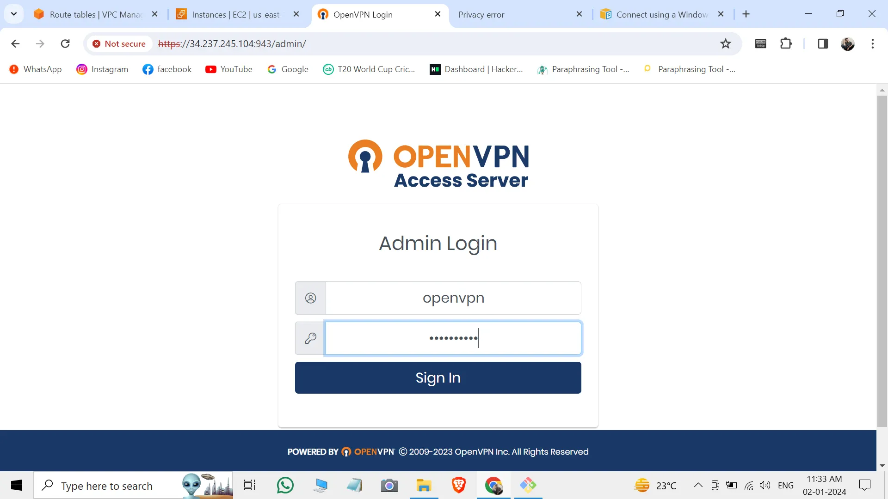
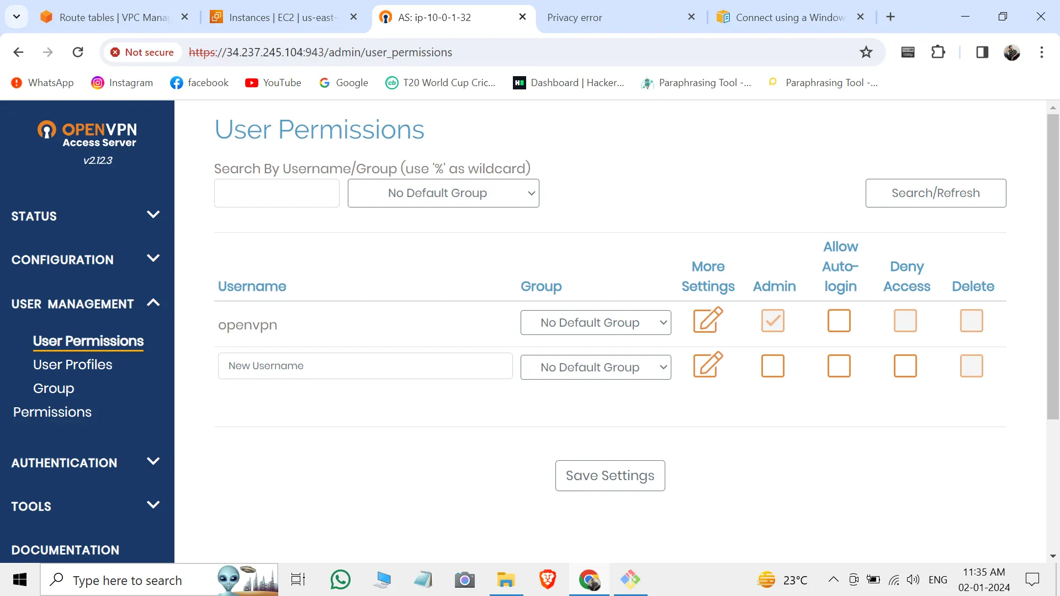
IMPLEMENTATION
Step 3: Connect to Admin UI

Slide 17
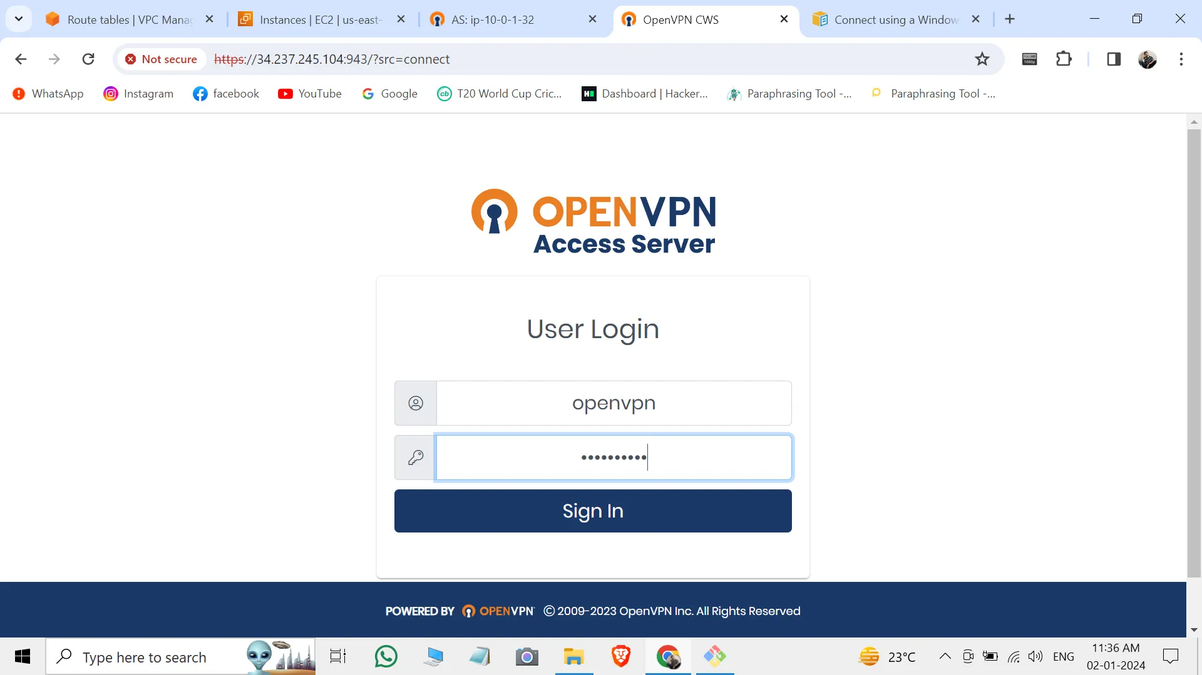
IMPLEMENTATION
Step 4: Connect to Client UI & Download Connection Profile
Connect to the Client UI.
Install the OpenVPN client app on your device.
Download the connection profile from the Client UI.

Slide 18
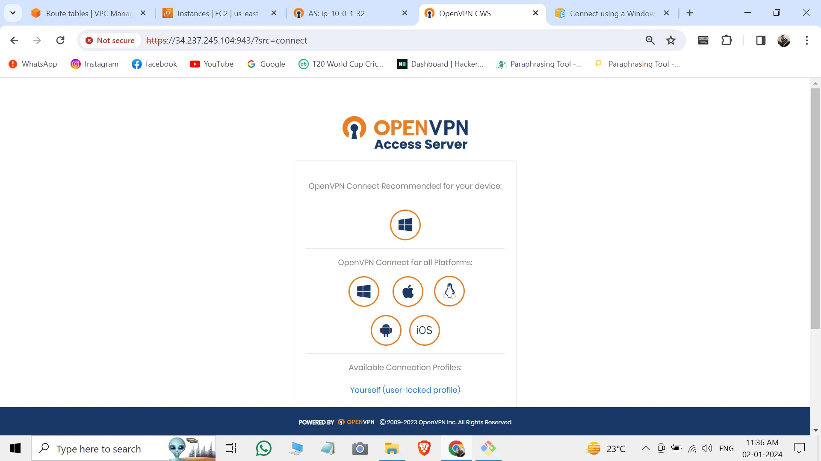
IMPLEMENTATION
Step 4: Connect to Client UI & Download Connection Profile

Slide 19
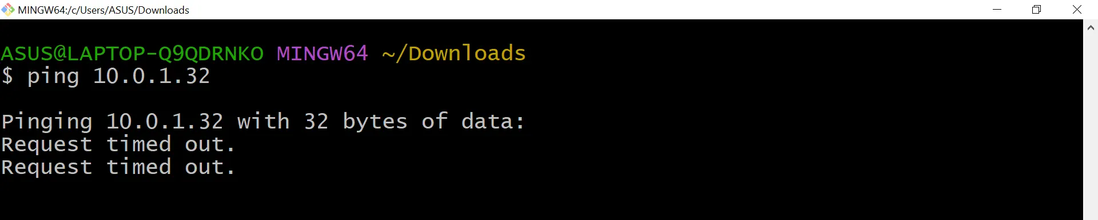
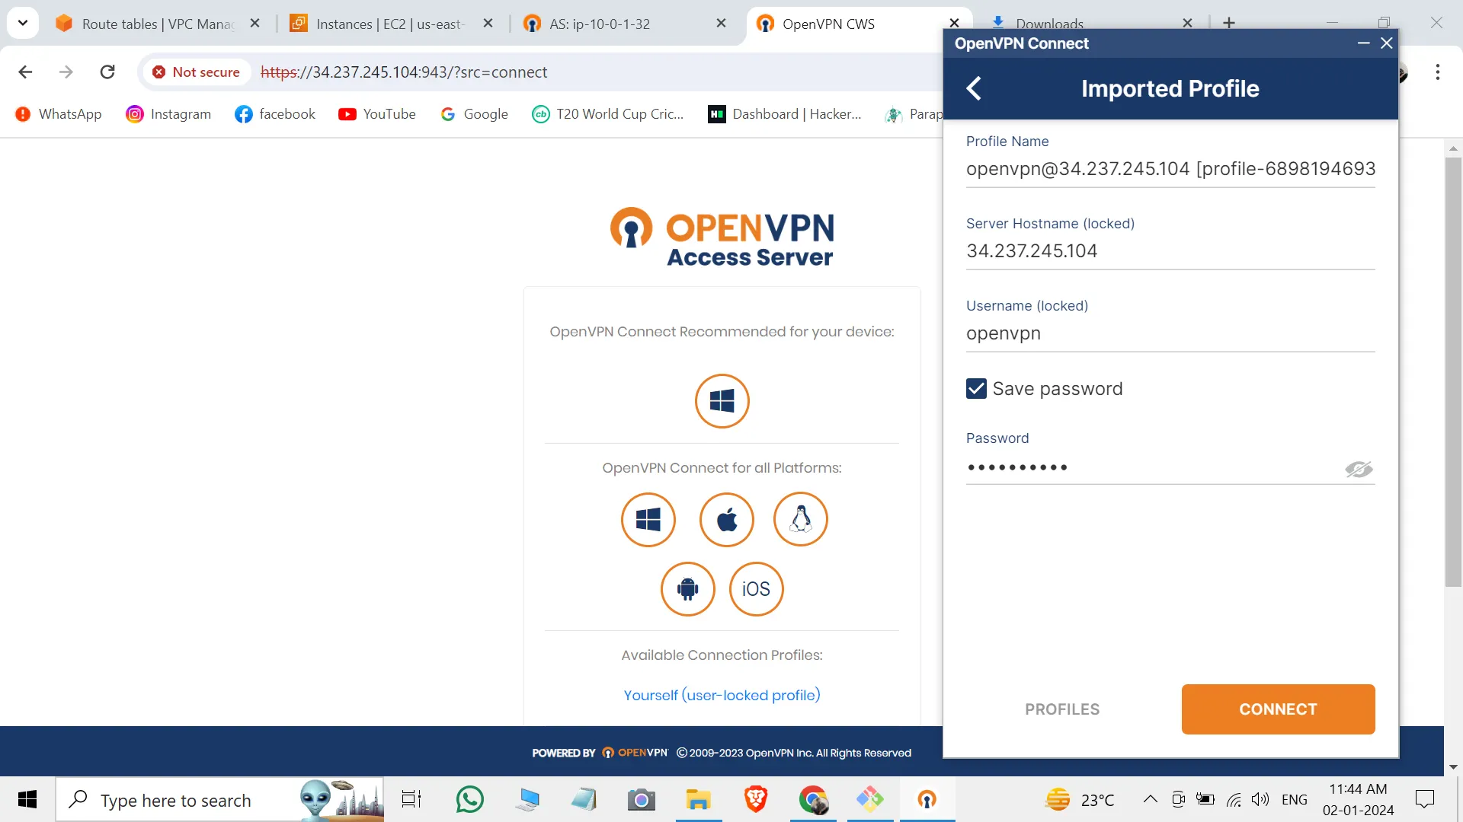
IMPLEMENTATION
Step 5: Test VPN Connection
Ping the Private IP of the OpenVPN server; it will not work.
Log in using the user ID and password in the OpenVPN client.
Upload the downloaded profile file then connect.

Slide 20
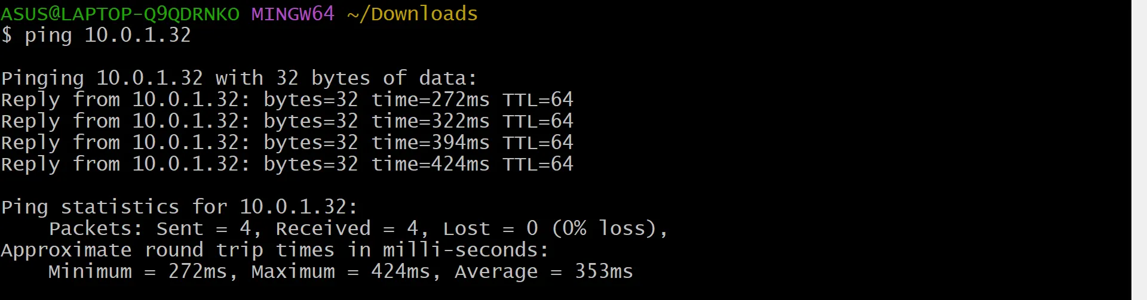
IMPLEMENTATION
Step 5: Test VPN Connection
Ping again

Slide 21
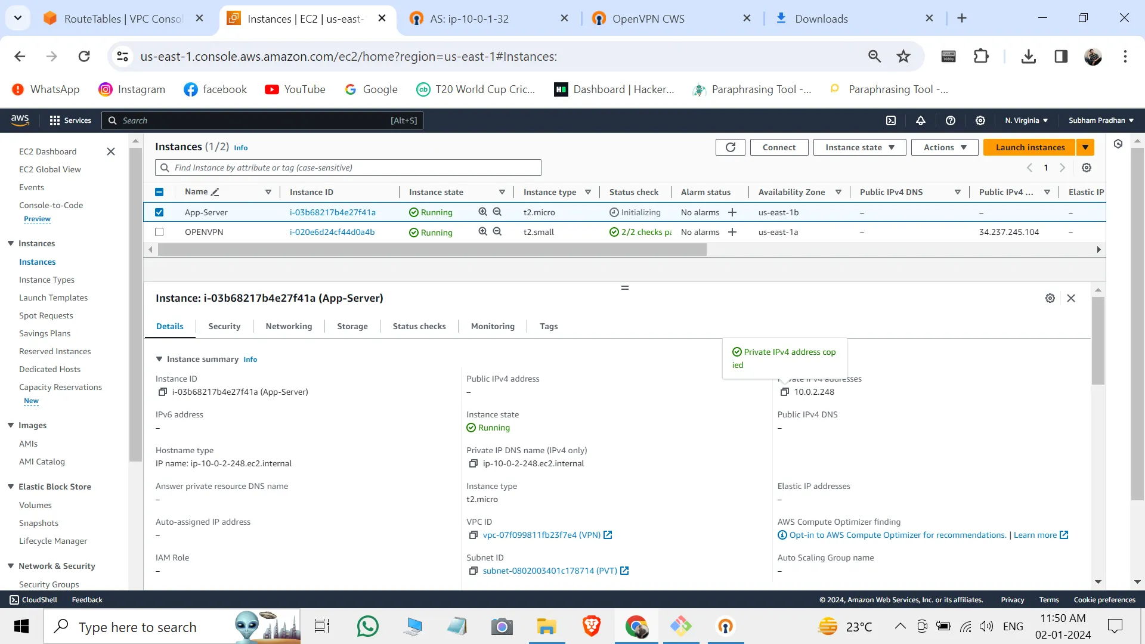
IMPLEMENTATION
Step 6: Create Additional Resources
Create another EC2 instance (APP-SERVER) in the PVT subnet.
Set up a NAT Gateway in the PUB subnet.
Route the NAT Gateway in the PVT subnet.

Slide 22
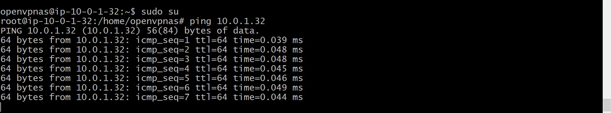
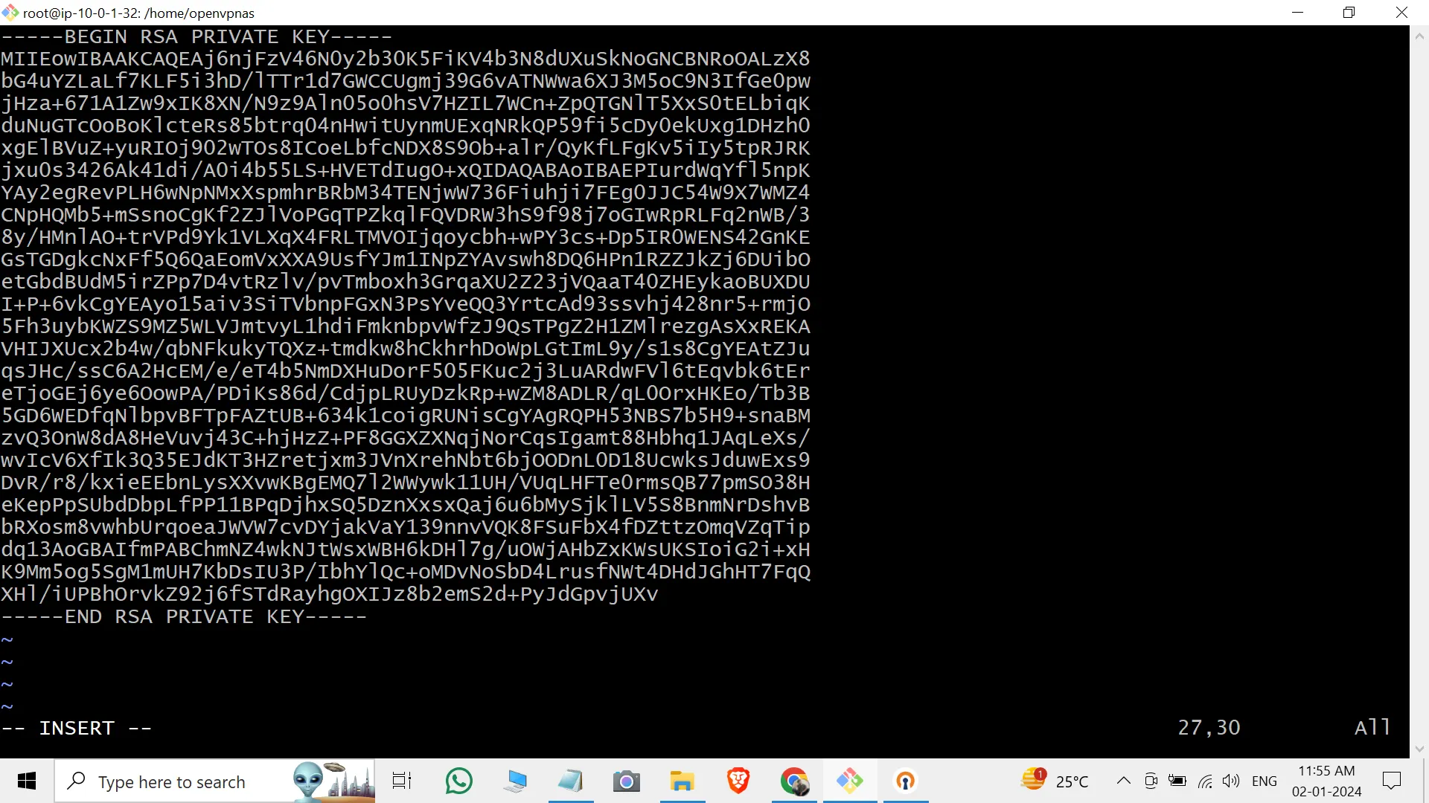
IMPLEMENTATION
Step 7: Test Communication with NAT Gateway
Reconnect to the OpenVPN server.
Ping the private IP of the APP-SERVER; it should ping due to the NAT Gateway.
Create a test-key on APP-SERVER, change permissions, and perform an SSH connection.

Slide 23
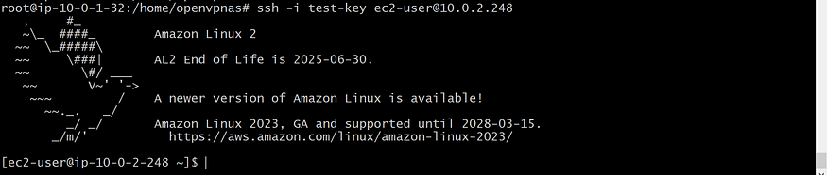
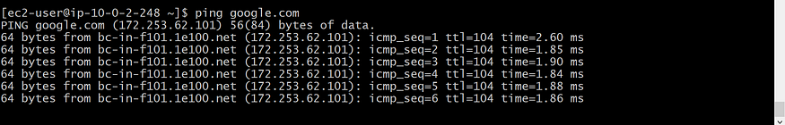
IMPLEMENTATION
Step 8: Install Apache Server on APP-SERVER
connect to the APP-SERVER.
ping google.com

Slide 24
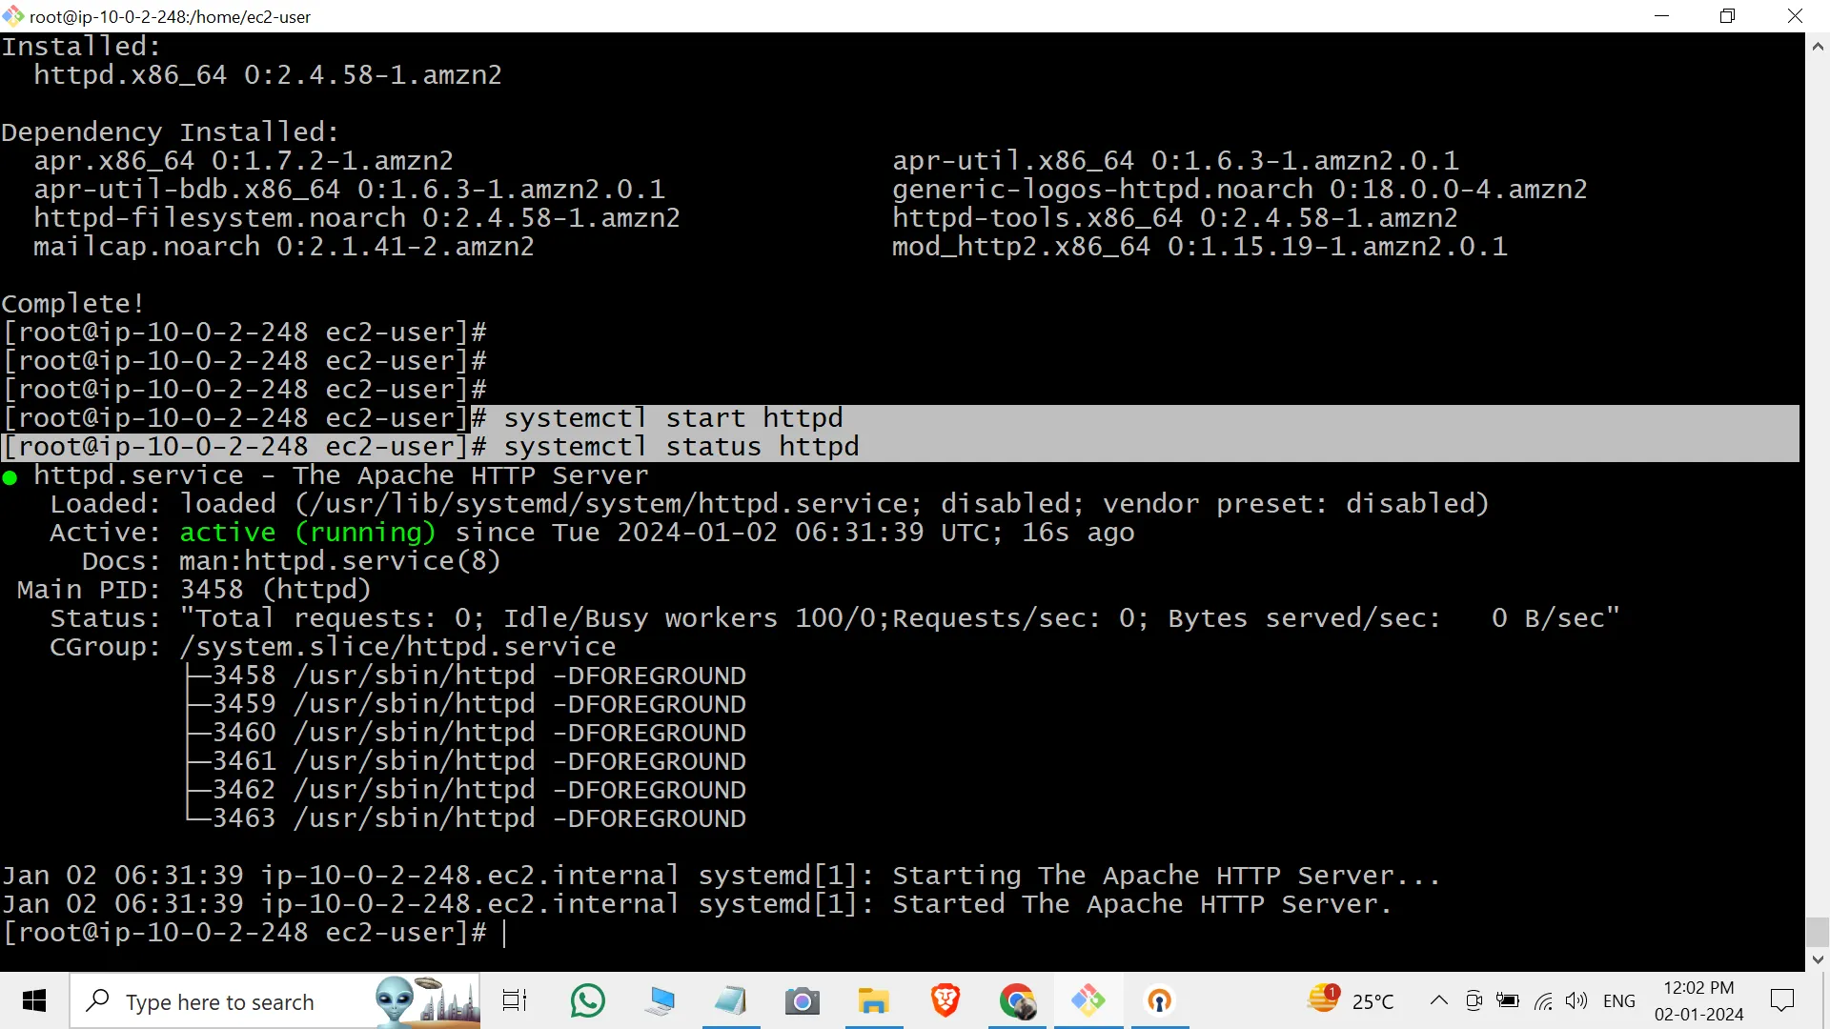
IMPLEMENTATION
Step 8: Install Apache Server on APP-SERVER
Switch to sudo su on APP-SERVER.
Install Apache: yum install httpd -y.
Start Apache: systemctl start httpd.
Check status: systemctl status httpd.

Slide 25
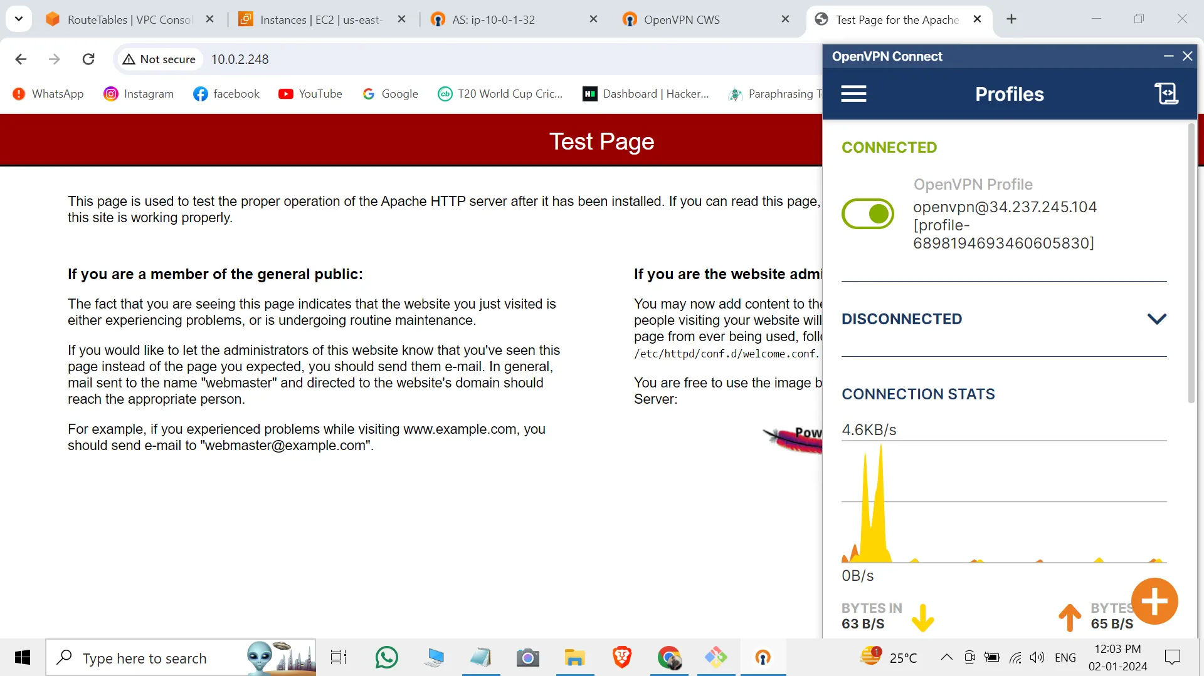
RESULT
Access Apache by pasting the private IP of APP-SERVER; it should display the Apache server.
(Note: Ensure that the VPN connection is active during testing.)

Slide 26
CONCLUSION
Implemented a secure Point-to-Site VPN using AWS Client VPN service.
Enabled remote user access to AWS VPC resources via an encrypted, OpenVPN-based tunnel.
Ensured confidentiality, integrity, and controlled access with mutual TLS authentication and AWS IAM/ACM integration.
Achieved scalability, flexibility (split-tunnel/full-tunnel), and observability.
Final outcome: Remote users can securely connect and manage AWS cloud resources as if they were inside the VPC without exposing them directly to the internet.

Slide 27
REFERENCES
AWS Documentation – Client VPN https://docs.aws.amazon.com/vpn/latest/clientvpn-admin/what-is.html
Medium – Point to Site Connection https://medium.com/@subhampradhan966/setting-up-point-to-site-vpn-connection-in-aws-a-step-by-step-guide-9edd65e6ca44
AWS Documentation – Tutorial: Create and Configure a Client VPN Endpoint https://docs.aws.amazon.com/vpn/latest/clientvpn-admin/cvpn-getting-started.html
Nord VPN - What is it, and how does it work? https://nordvpn.com/blog/point-to-site-vpn/?srsltid=AfmBOoruoxZL6qczyCqvfo1h1imnnMaWL4FkDnzhw1AZ2yWUOlRPsyG5

